Slide 1
Single Strap Antenna
Antenna box from x=0
Plasma from x=x_plasma
w_strap
d_wall
d_strap
y
y
e_strap
h_box
h_strap
x
z
vacuum
w_box
d_box
Name Value Unit "Evaluated Value" Type
d_strap 40 mm 40mm Design
e_strap 15 mm 15mm Design
w_strap 120 mm 120mm Design
h_strap 200 mm 200mm Design
w_box 200 mm 200mm Design
d_box 160 mm 160mm Design
h_box 250 mm 250mm Design
x_plasma 10 mm 10mm Design
w_vacuum 550 mm 550mm Design
h_vacuum 800 mm 800mm Design
d_vacuum 400 mm 400mm Design
d_plasma "d_vacuum -x_plasma" 390mm Design
h_plasma h_vacuum 800mm Design
w_plasma w_vacuum 550mm Design
F = 50 MHz
I = 1 A

Slide 2
Double Straps Antenna
Antenna box from x=0
Plasma from x=x_edge
w_strap
d_wall
delta_strap
d_strap
y
y
e_strap
h_box
h_strap
x
z
vacuum
w_box
d_box

Slide 3
Plasma Configurations
n_e
n_e0
Constant density plasma
0
x_plasma
x
n_e
Dn_e0
Single gradient plasma
n_e0
0
x_plasma
x
ANTITER: Base density for vacuum is n_edge=1e11
This is made for numerics but has a very low impact on kperp in vacuum

Slide 4
Frist case: Double strap – constant profile

Slide 5
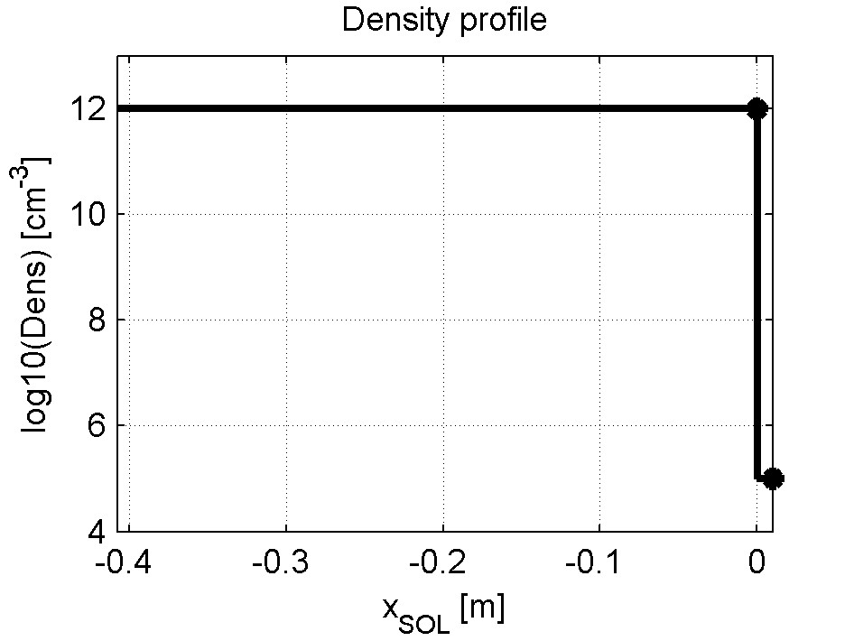
Plasma Configuration
Constant density plasma
n_e
Units:
Lengths: m
Density: m-3
!! ANTITIER
Density: cm-3
n_e0
Constant density plasma
0
x_plasma
x
x_plasma=0.01
n_e0=1e18
ANTITER uses a slightly different reference system
n_e
n_e0
x
0
x_ant=x_plasma

Slide 6
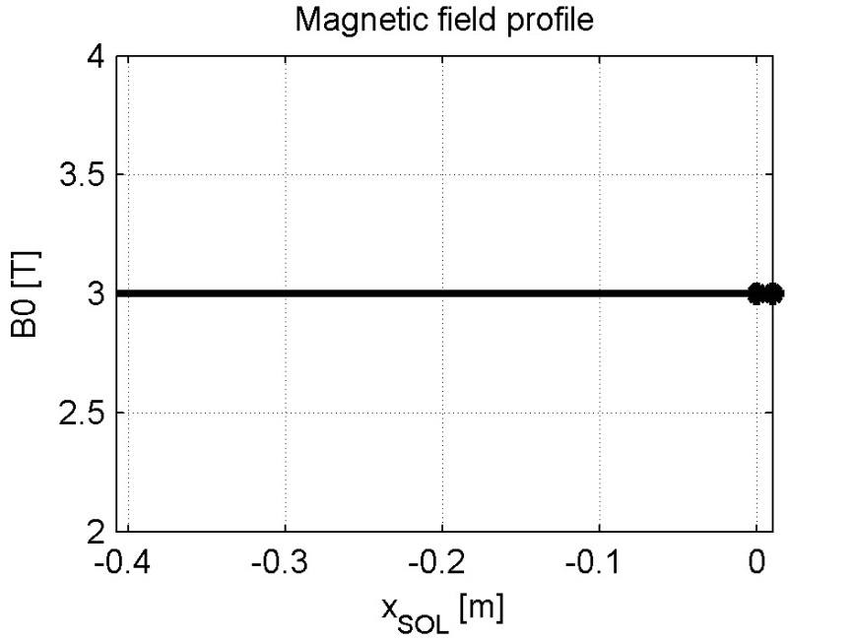
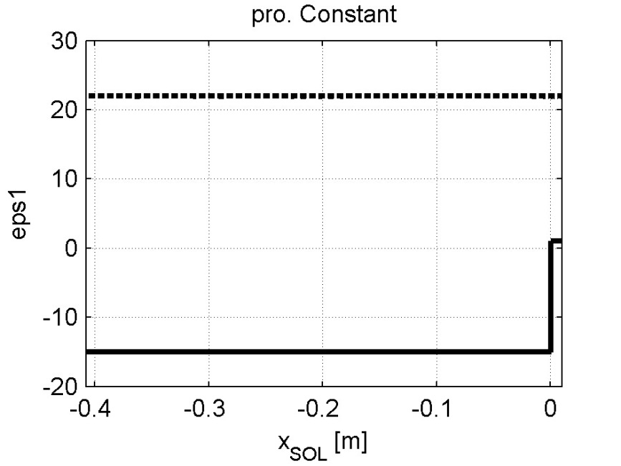
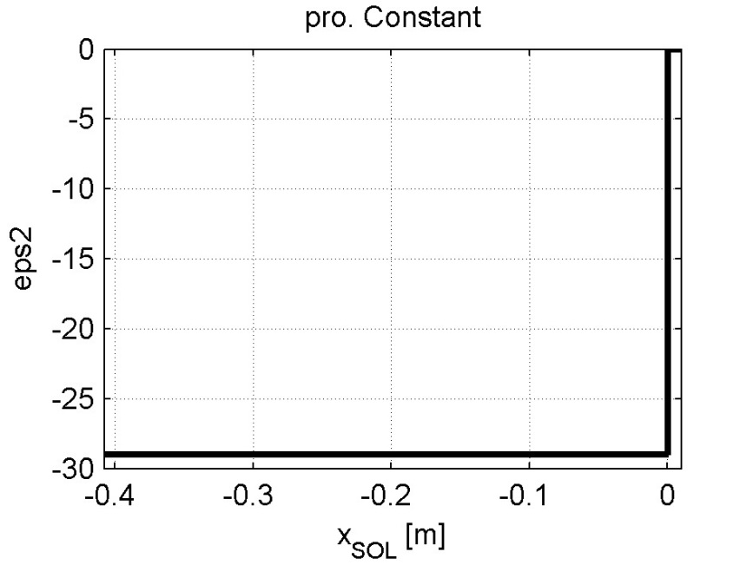
Plasma Conf. 1e8
Constant density plasma
B is taken constant but could have the usual 1/R dependency
x_plasma=0.01
n_e0=1e18
f=50MHz
D(H)5%
ANTITER is considering only the fast magneto-sonic wave (FMW) so the palsma is described by eps1 ( Stix S) and eps2 (Stix D)

Slide 7
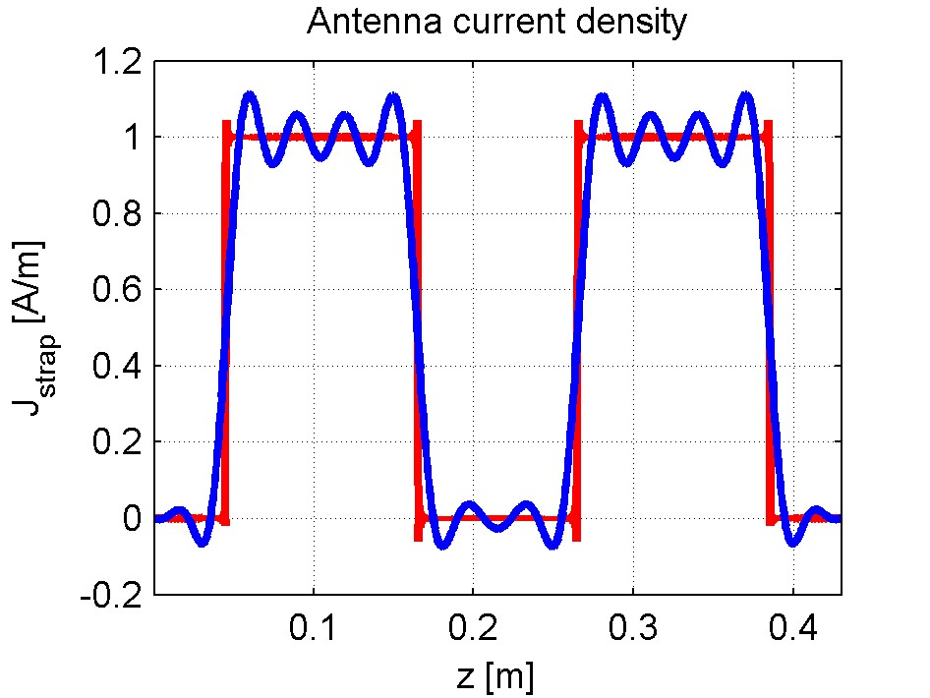
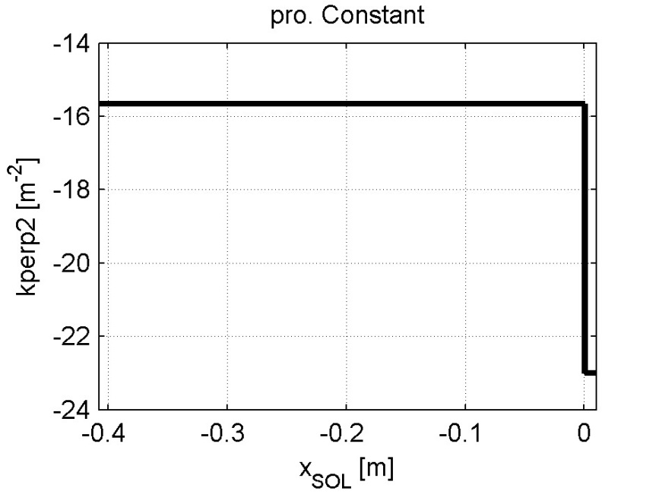
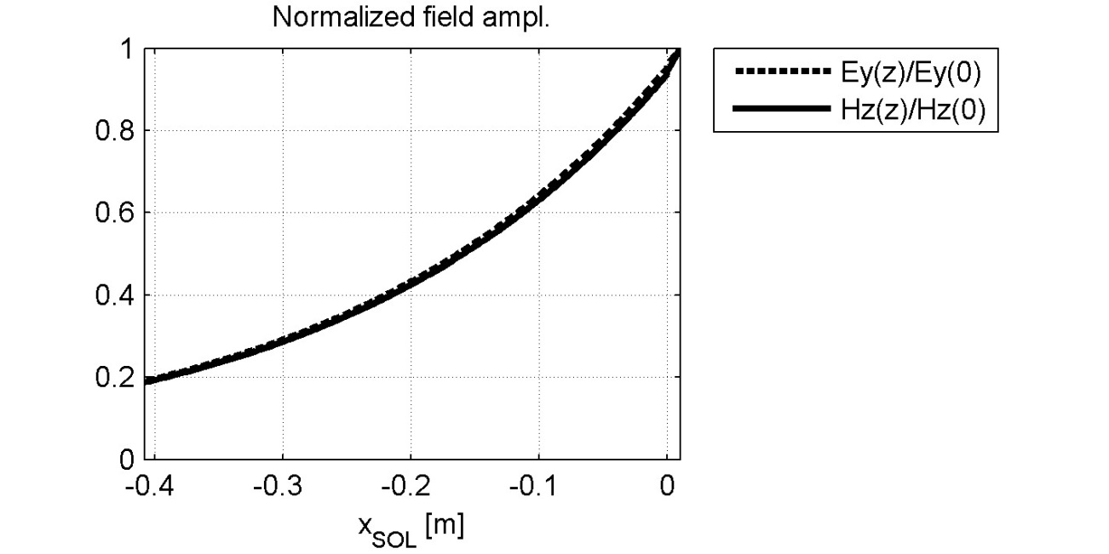
Plasma Conf. 1e8
Constant density plasma
30 elements in the expansion of J.
(Seems enough, checked for convergence. Could be increased.)
f=50MHz
D(H)5%

Slide 8
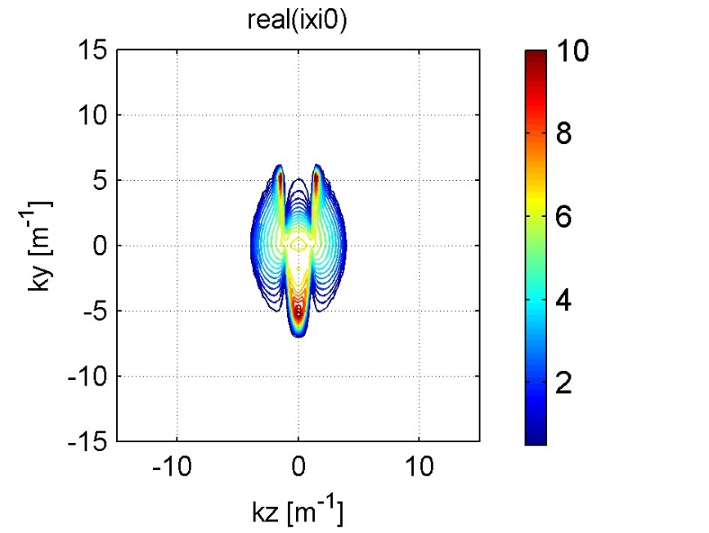
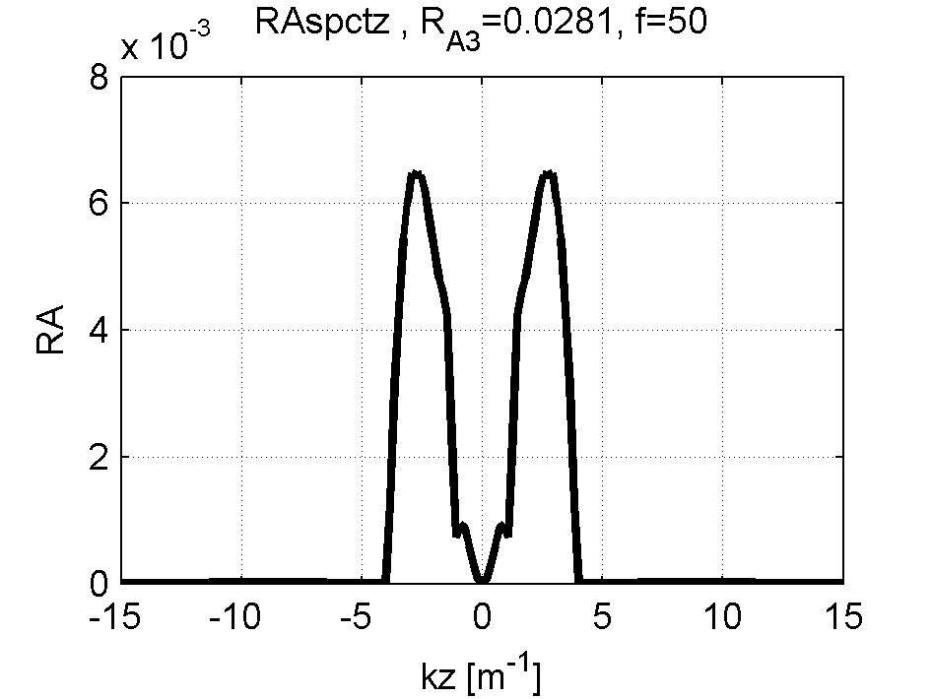
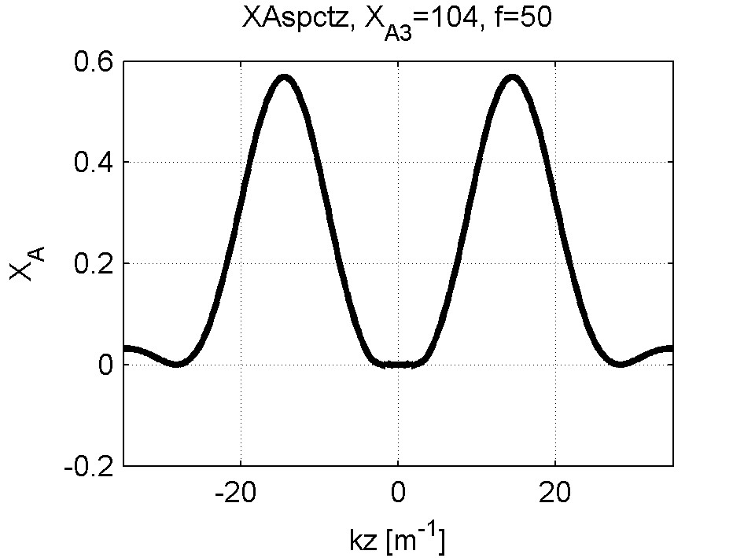
Plasma Response 1e8
Constant density plasma
n_e0=1e18
f=50MHz
D(H)5%
Z₁₁=(2.0-i128.4)ohm/m
Z₂₁=(2.0-i24.7)ohm/m
Dipole phasing
Z_{A}=R_{A3}+iX_{A3}

Slide 9
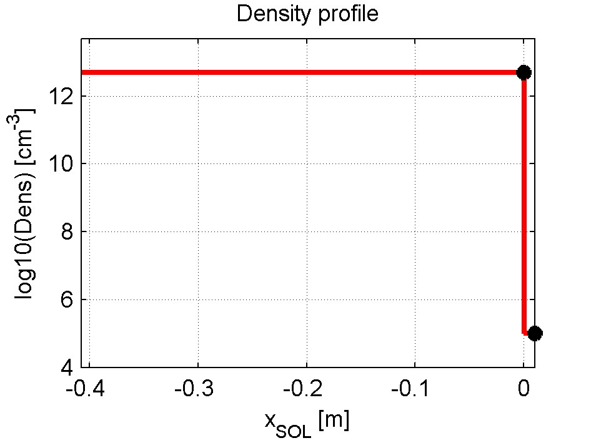
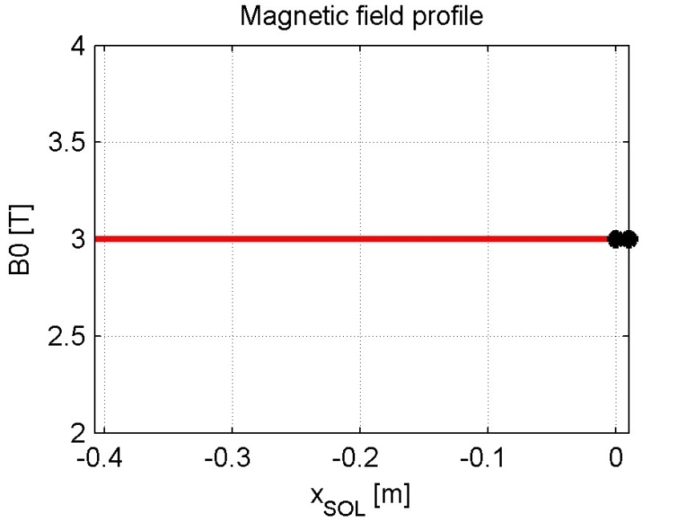
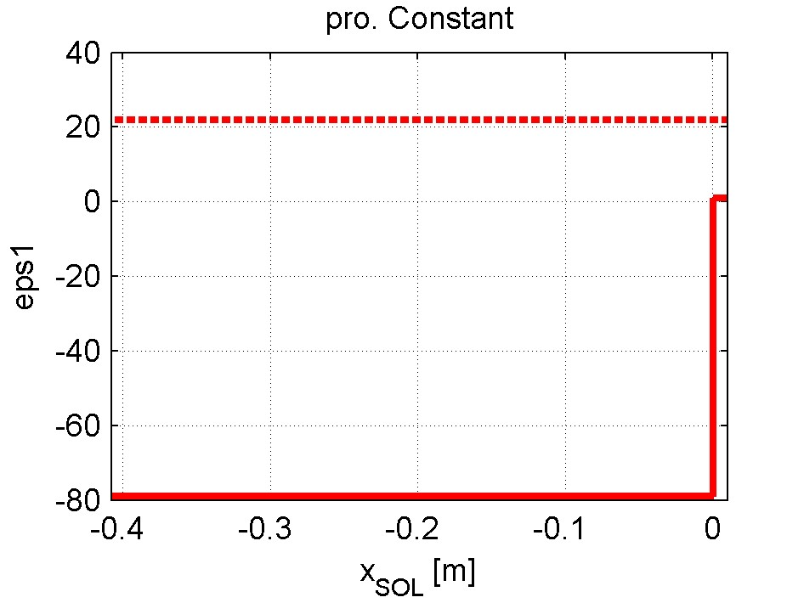
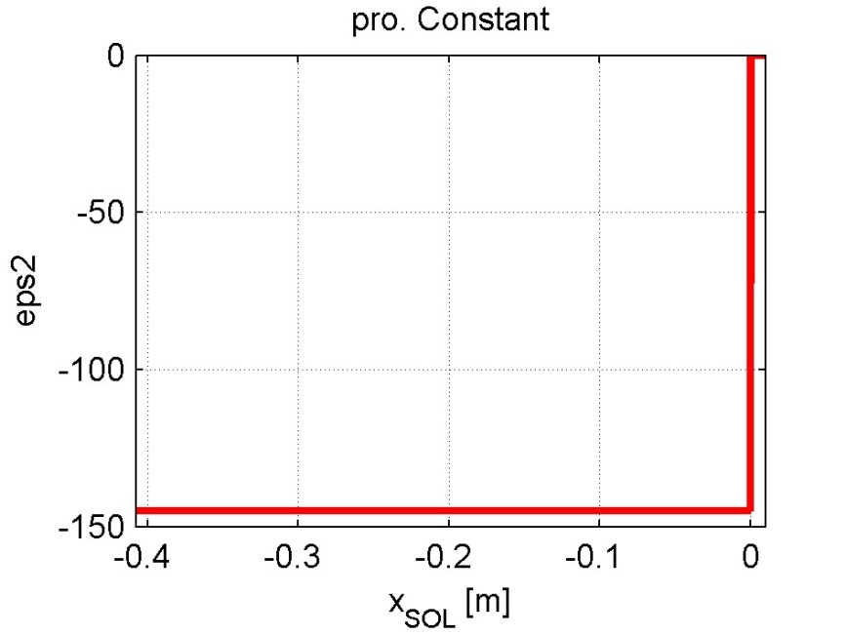
Plasma Conf. 5e8
Constant density plasma
x_plasma=0.01
n_e0=5e18
n_e0=5e18
f=50MHz
D(H)5%

Slide 10
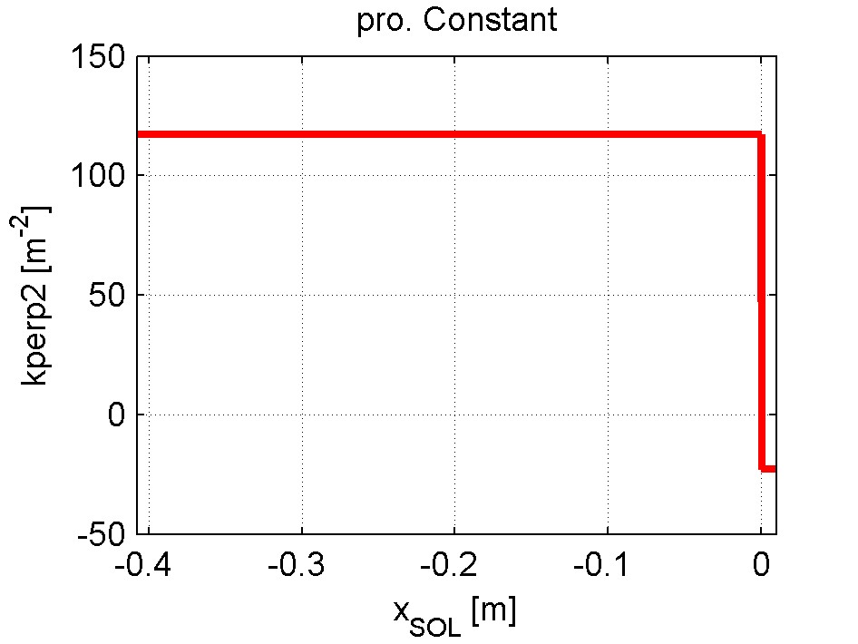
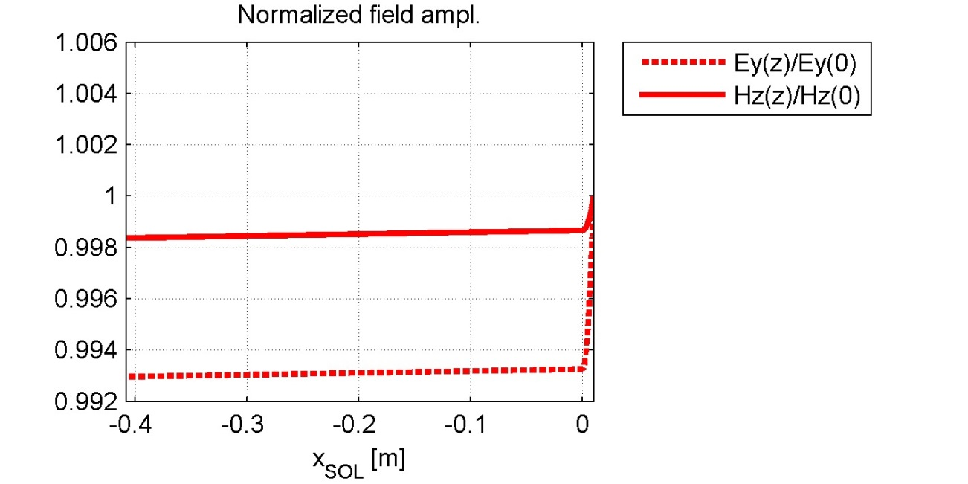
Plasma Conf. 5e8
Constant density plasma
30 elements in the expansion of J
n_e0=5e18
f=50MHz
D(H)5%

Slide 11
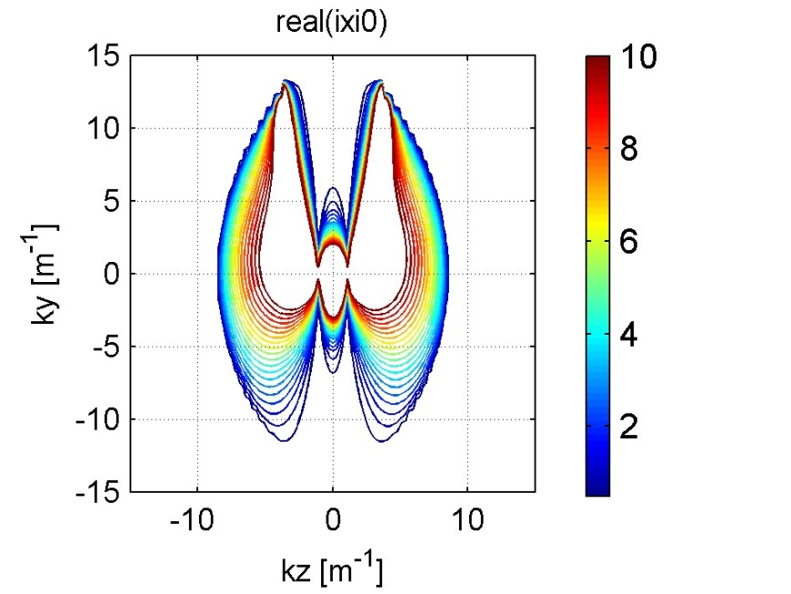
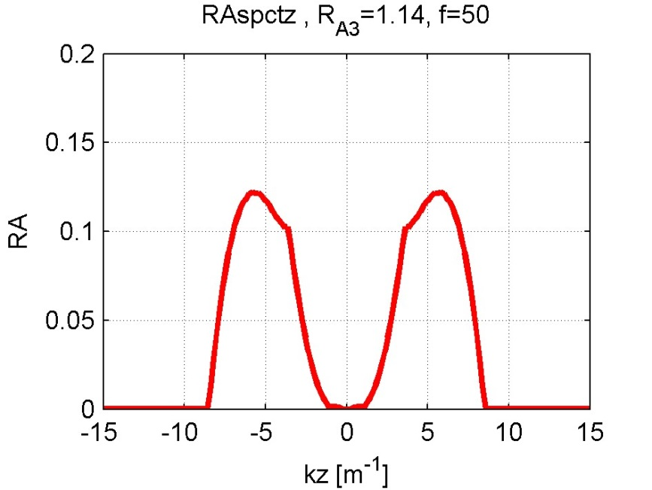
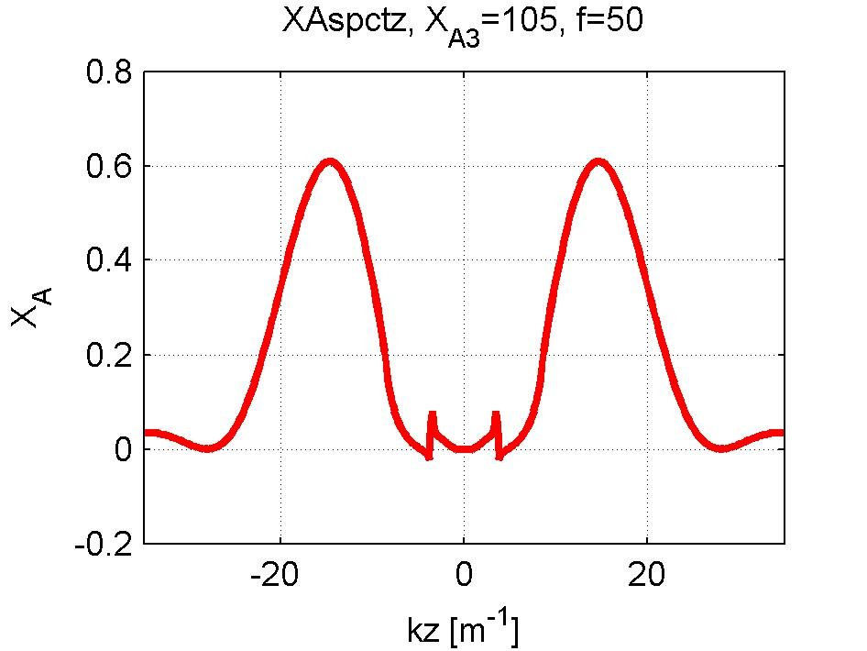
Plasma Response 5e8
Constant density plasma
n_e0=5e18
f=50MHz
D(H)5%
Z₁₁=(12.9-i126.9)ohm/m
Z₂₁=(11.8-i22.1)ohm/m
Dipole phasing
Z_{A}=R_{A3}+iX_{A3}

Slide 12
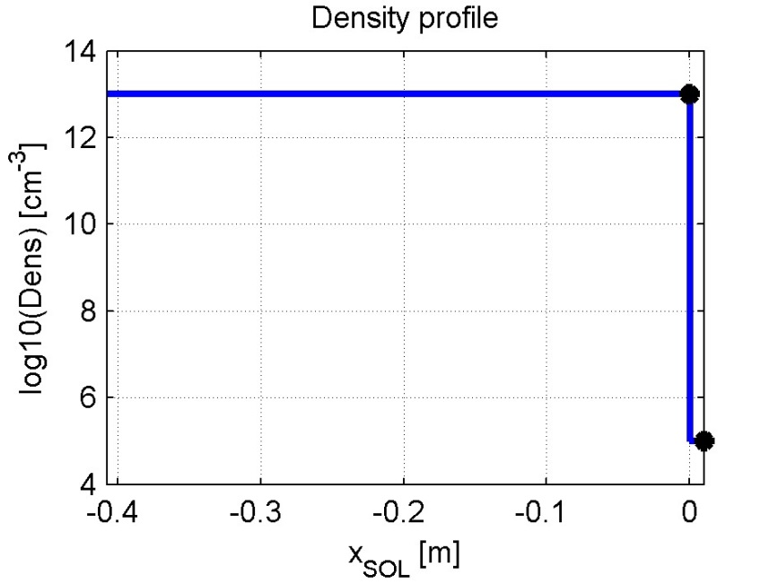
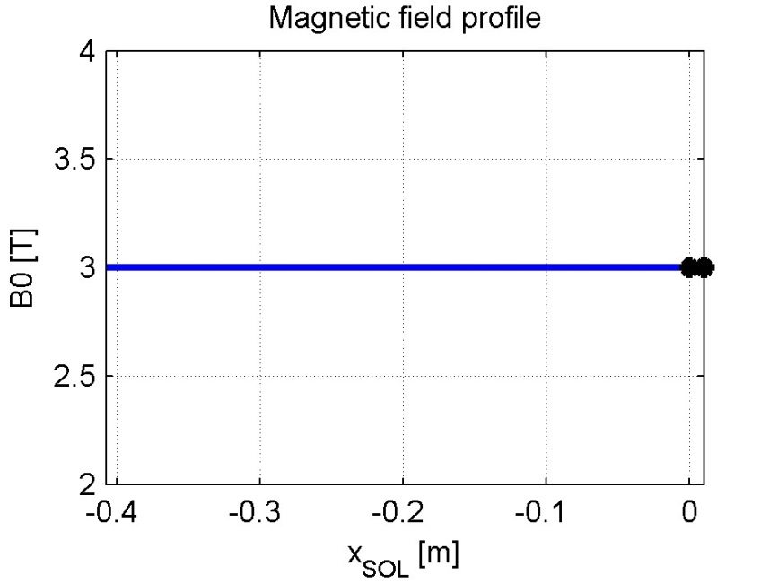
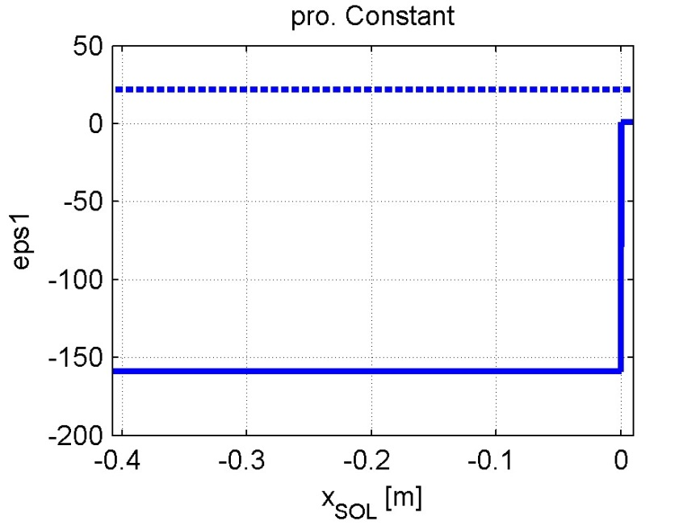
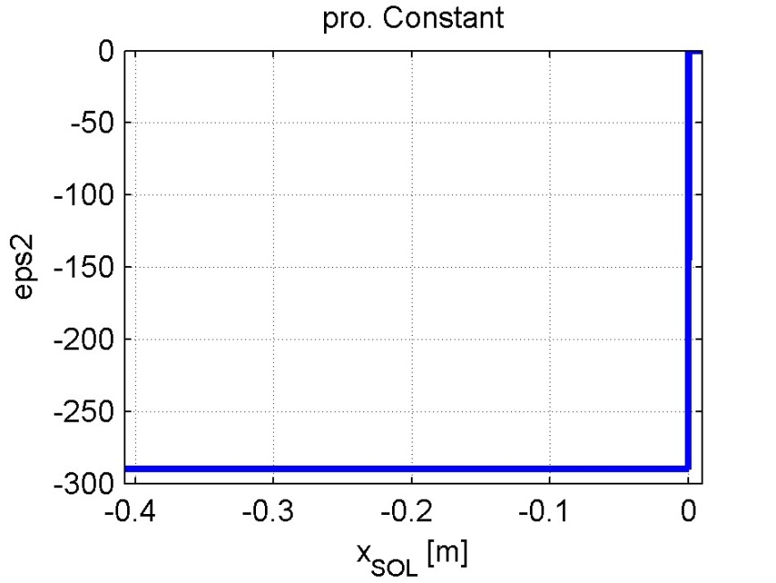
Plasma Conf. 10e8
Constant density plasma
x_plasma=0.01
n_e0=10e18
n_e0=10e18
f=50MHz
D(H)5%

Slide 13
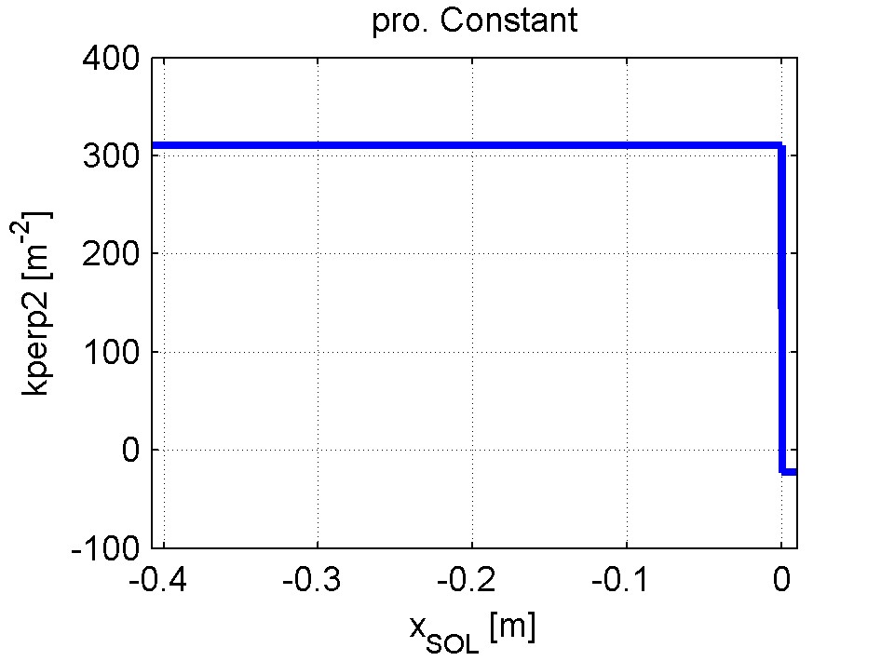
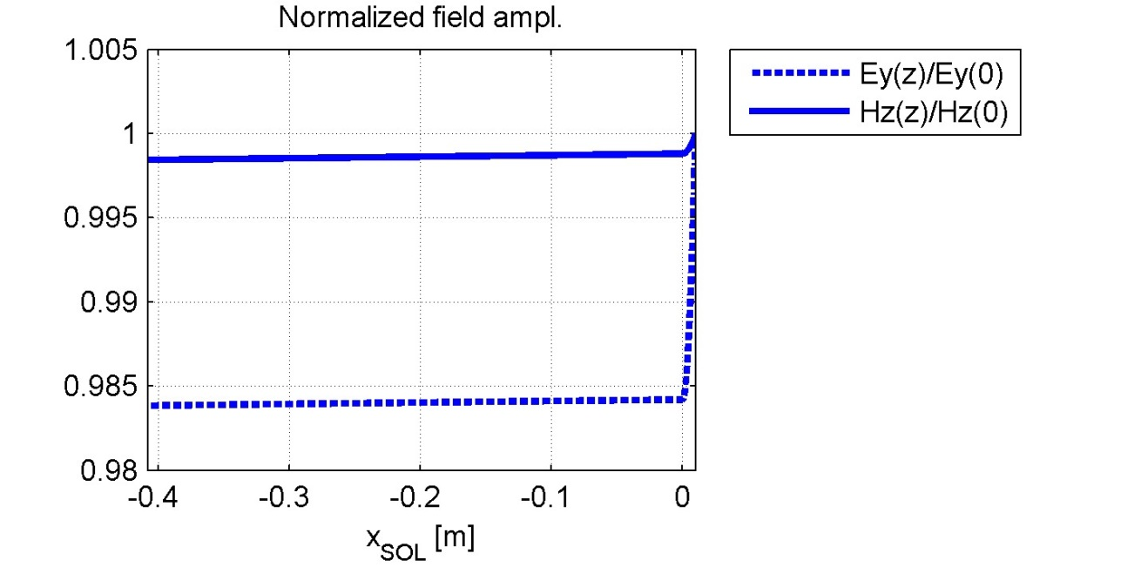
Plasma Conf. 10e8
Constant density plasma
30 elements in the expansion of J
n_e0=10e18
f=50MHz
D(H)5%

Slide 14
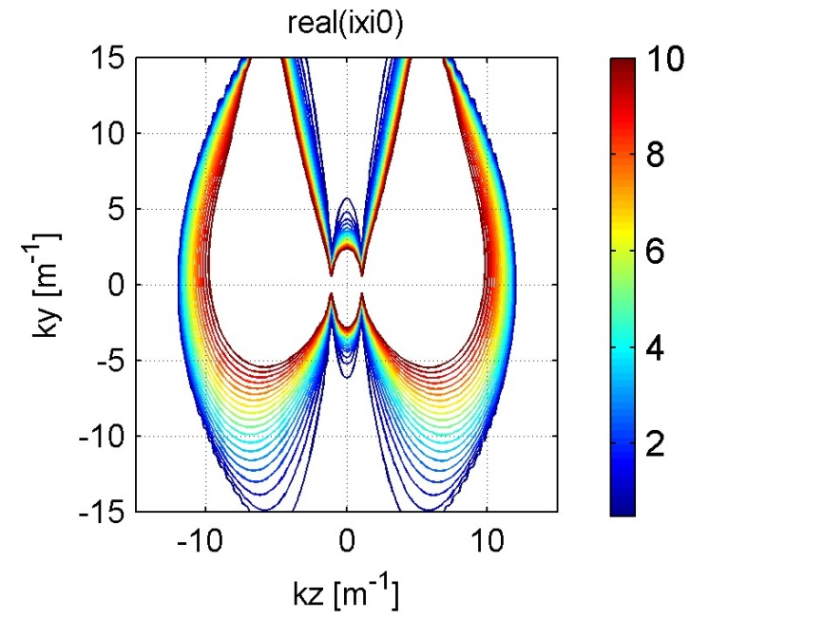
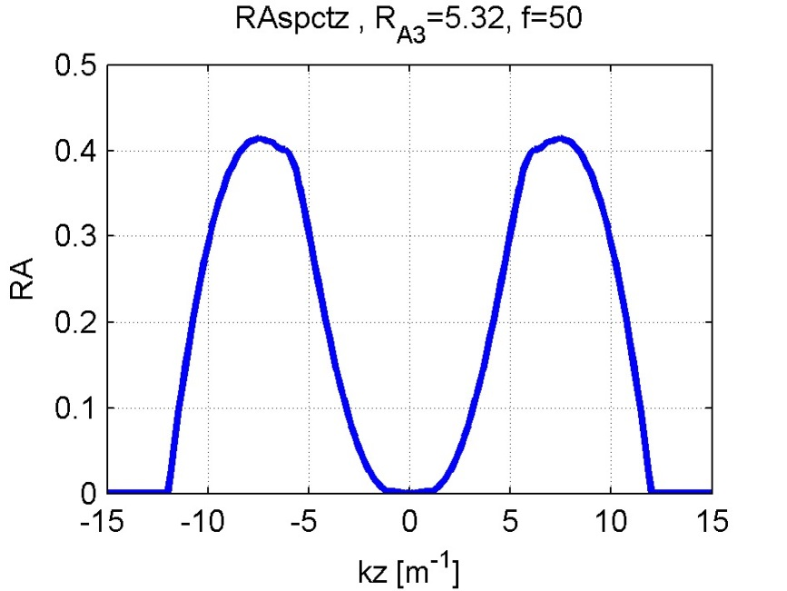
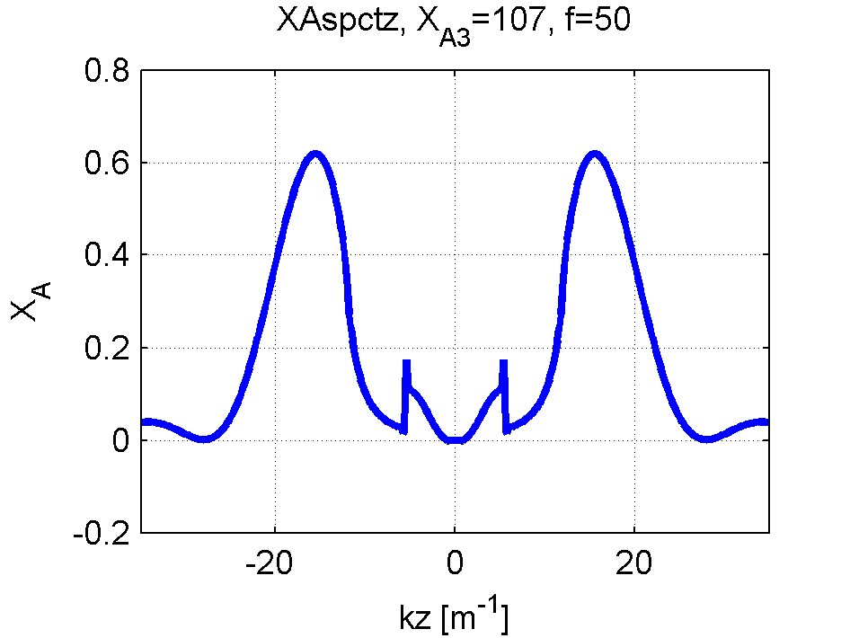
Plasma Response 10e8
Constant density plasma
n_e0=10e18
f=50MHz
D(H)5%
Z₁₁=(20.3-i119.2)ohm/m
Z₂₁=(15.0-i12.5)ohm/m
Dipole phasing
Z_{A}=R_{A3}+iX_{A3}

Slide 15
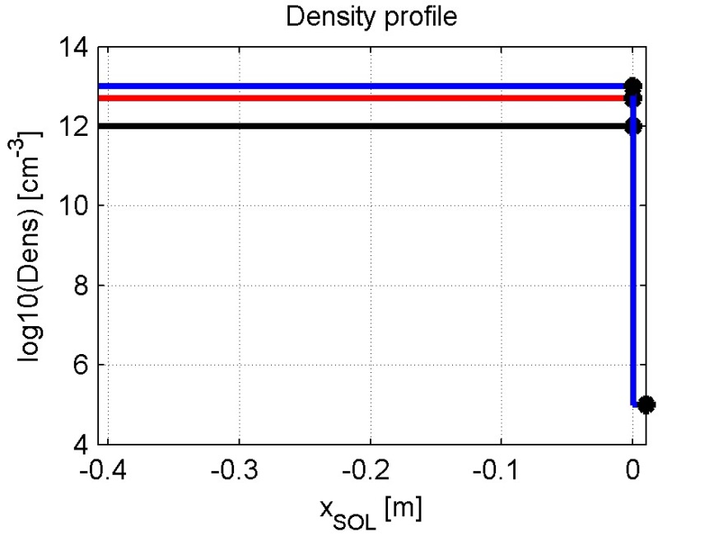
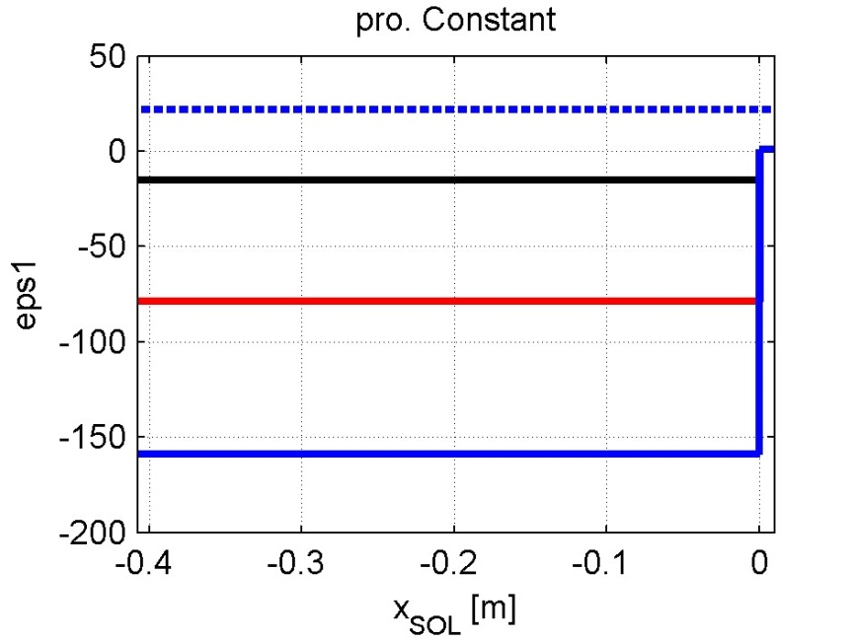
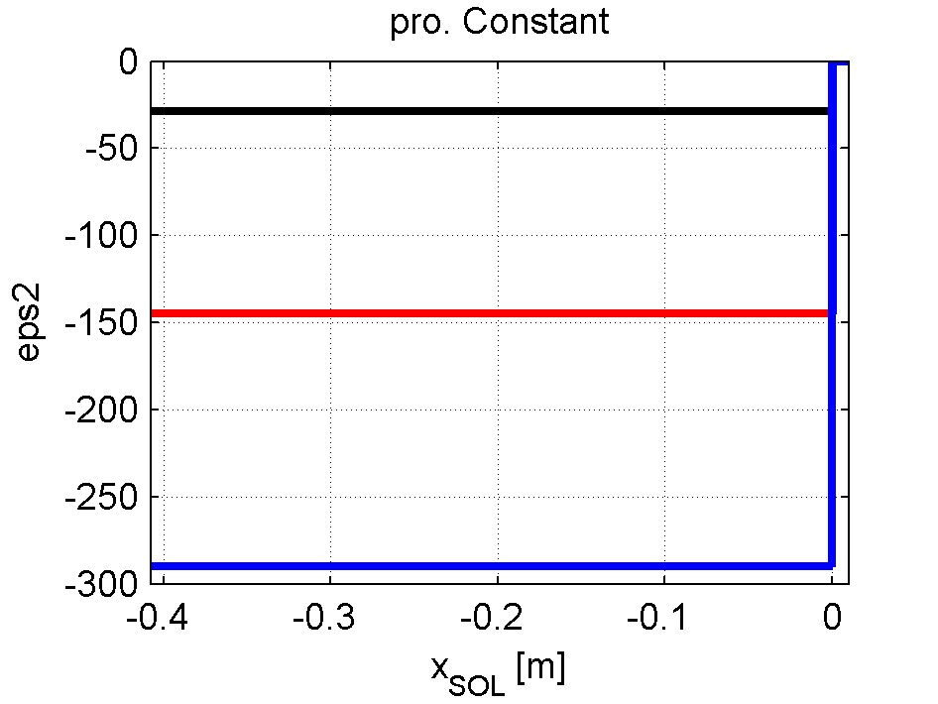
Plasma Conf. compar
Constant density plasma
n_e0 = 1e18
5e18
10e18
f=50MHz
D(H)5%

Slide 16
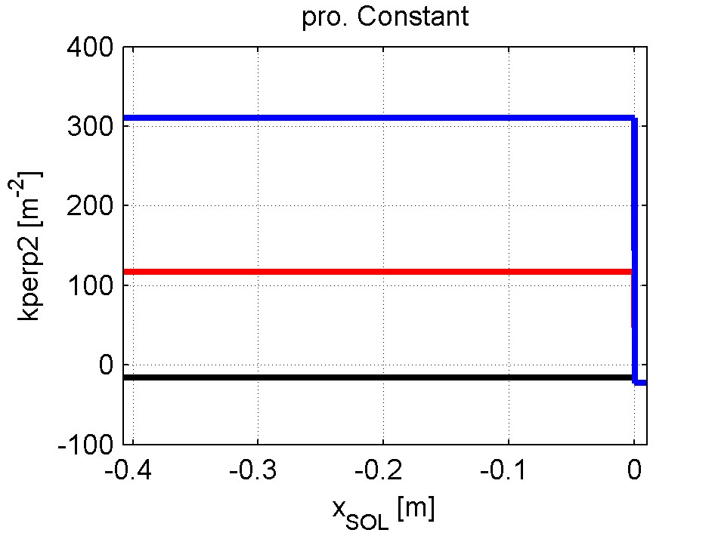
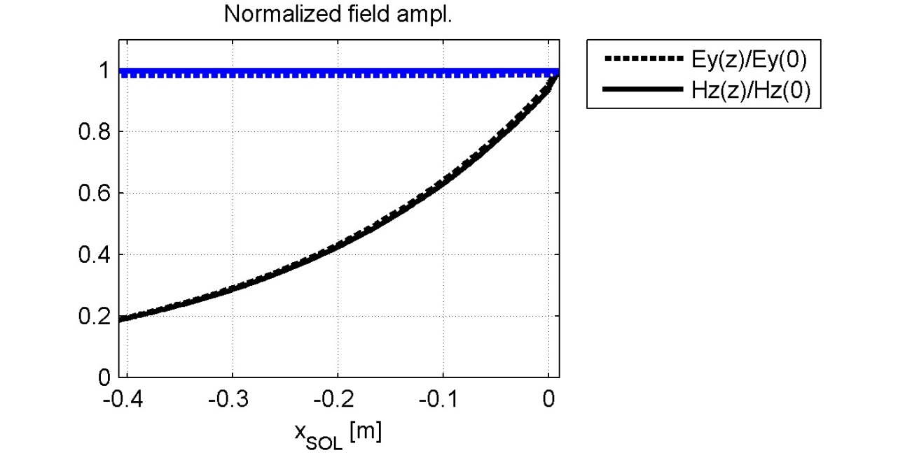
Plasma Conf. compar
Constant density plasma
30 elements in the expansion of J
n_e0 = 1e18
5e18
10e18
f=50MHz
D(H)5%

Slide 17
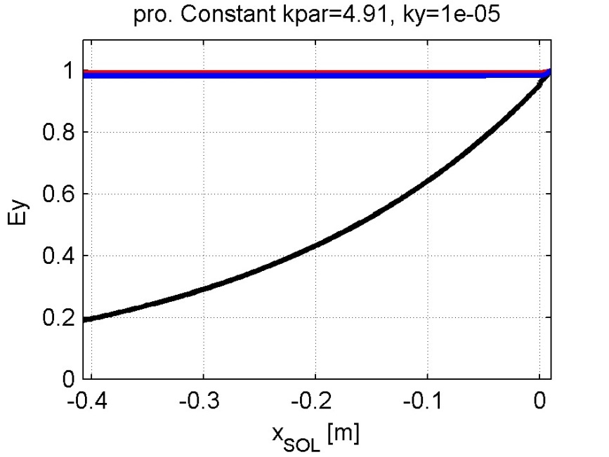
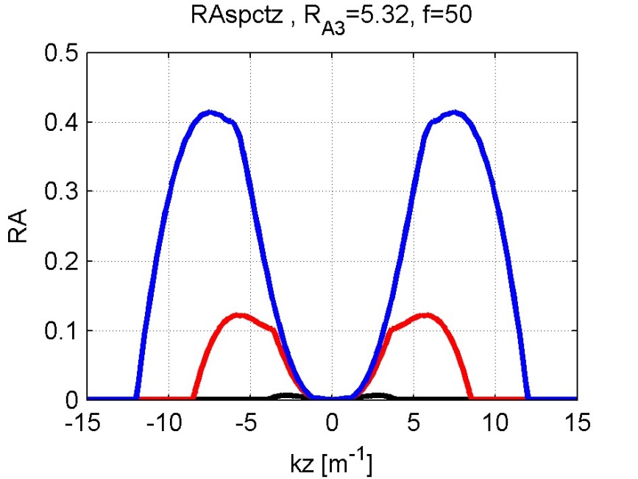
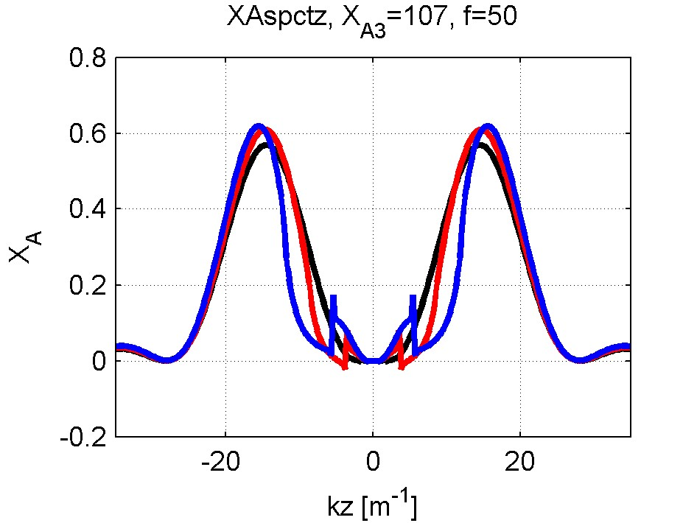
Plasma Response compar
Constant density plasma
n_e0 = 1e18
5e18
10e18
f=50MHz
D(H)5%
Dipole phasing

Slide 18
Second case: Single strap – constant profile

Slide 19
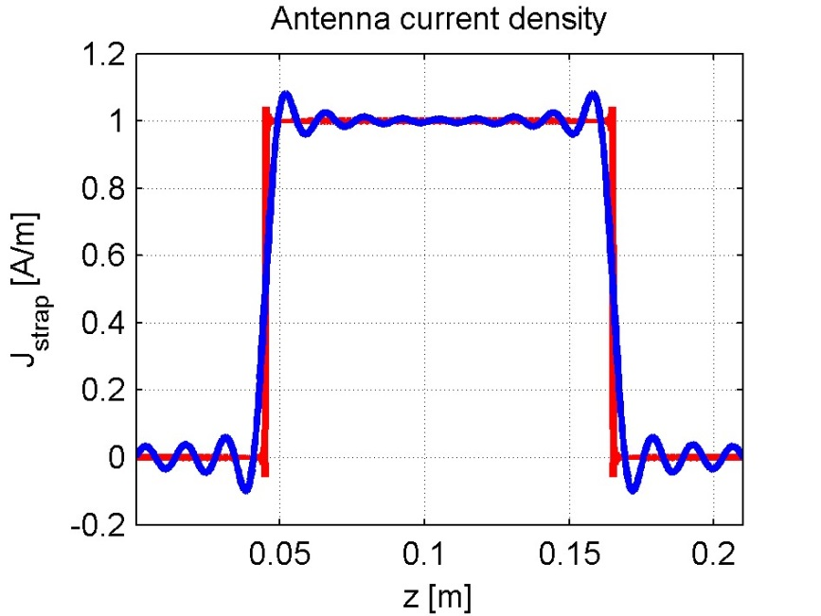
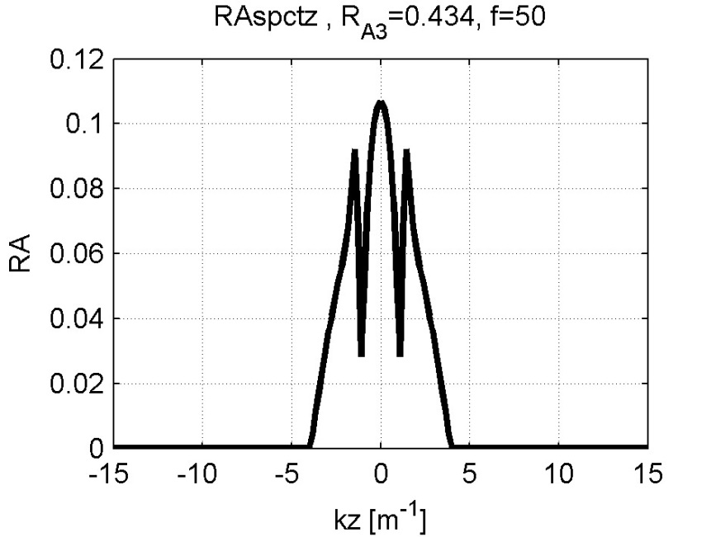
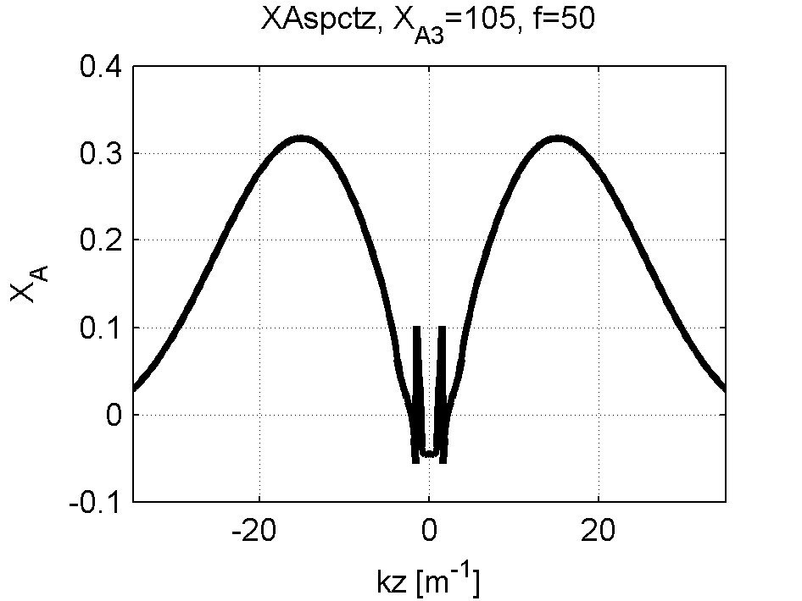
Plasma Response 1e8
Constant density plasma
30 elements in the expansion of J
n_e0=1e18
f=50MHz
D(H)5%
Z_{A}=R_{A3}+iX_{A3}
0.44+i105

Slide 20
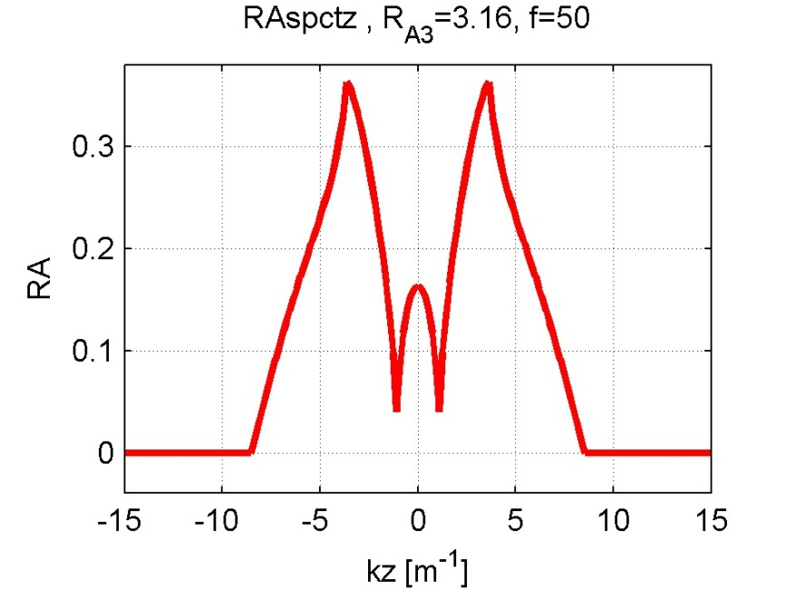
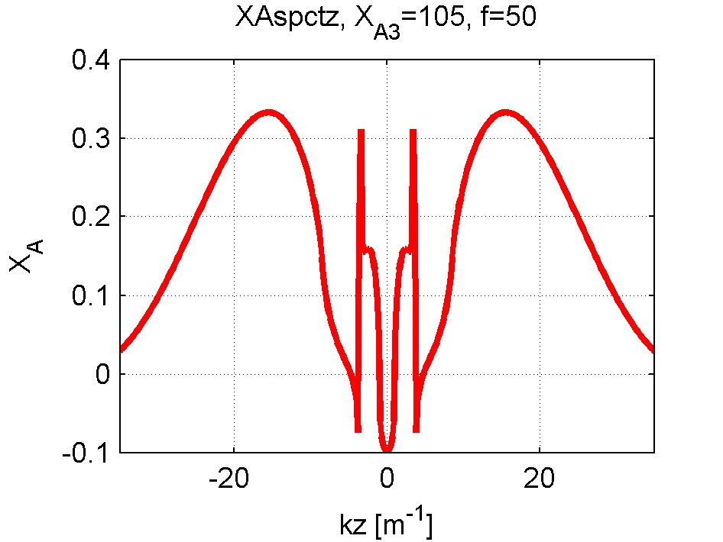
Plasma Response 5e8
Constant density plasma
30 elements in the expansion of J
n_e0=5e18
f=50MHz
D(H)5%
Z_{A}=R_{A3}+iX_{A3}
=3.16+i105

Slide 21
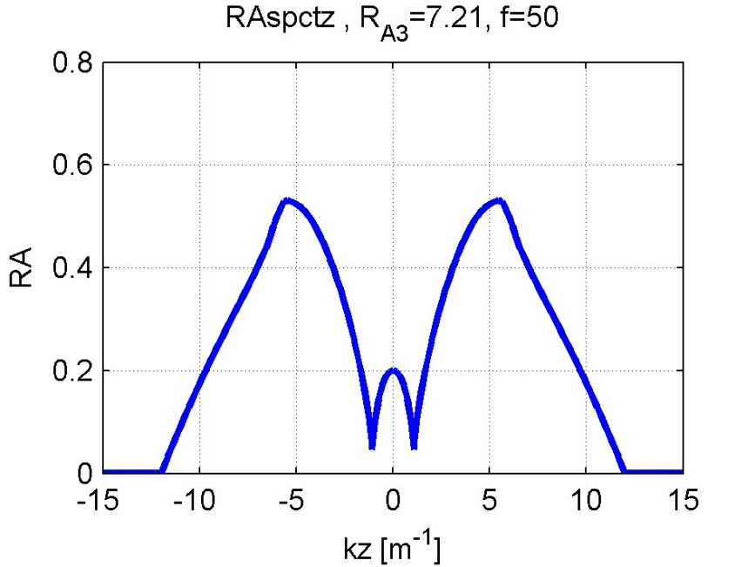
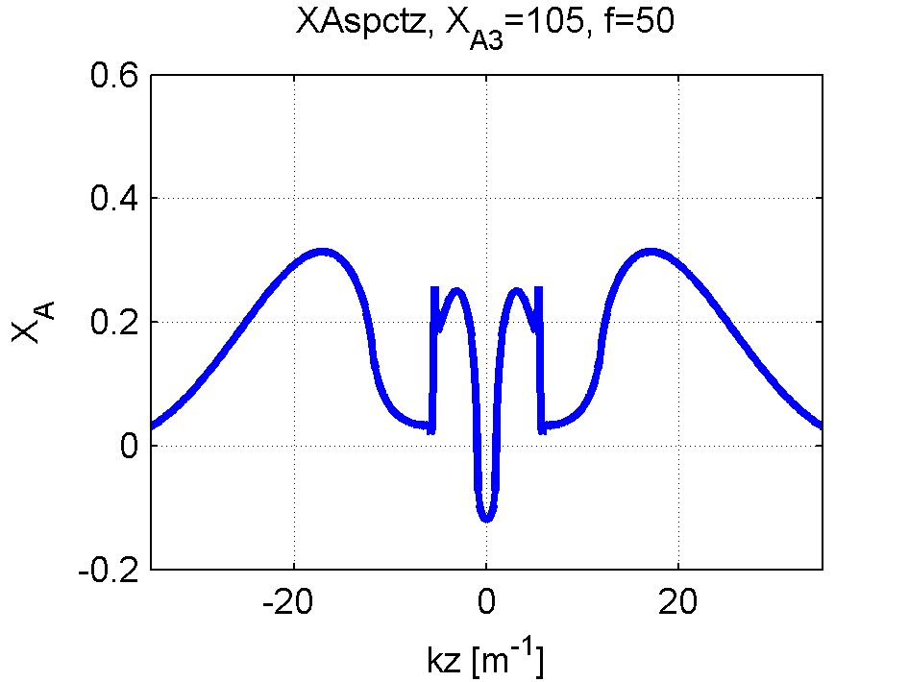
Plasma Response 10e8
Constant density plasma
30 elements in the expansion of J
n_e0=10e18
f=50MHz
D(H)5%
Z_{A}=R_{A3}+iX_{A3}
=7.21+i105

Slide 22
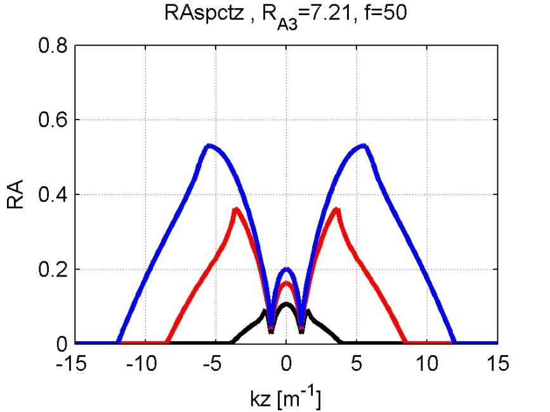
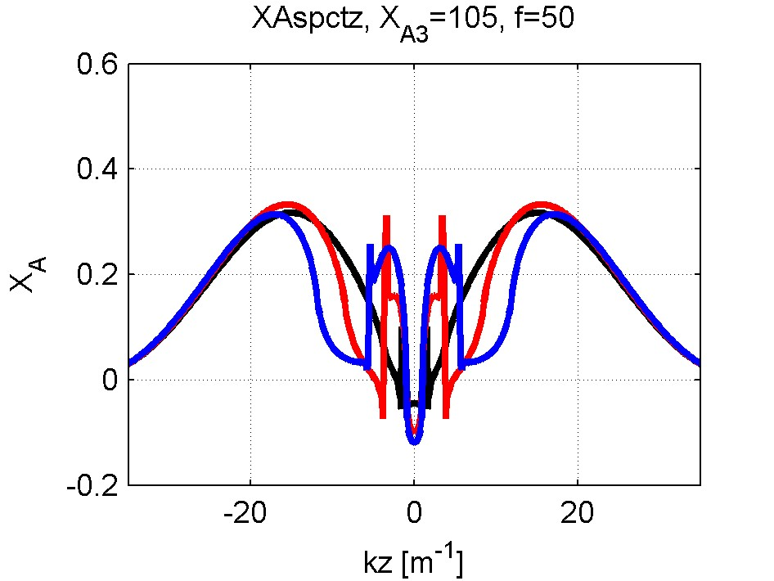
Plasma Response Compar
Constant density plasma
30 elements in the expansion of J
n_e0=10e18
f=50MHz
D(H)5%

